Slide 1

Predictive Analysis: customer buying behaviour
5 April 2023 Viswanatha Sharma Chepuri, Data Scientist MSc

Slide 2
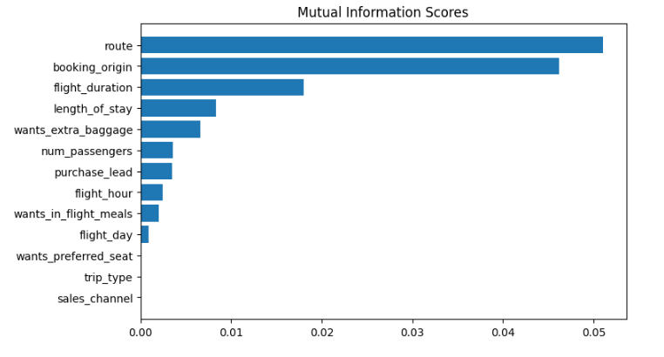
predictive model to understand factors that influence buying behaviour
The predictive model trained on Xgboost Classifier and performed evaluation.
Test Accuracy: 85%
AUC score: 0.558
route
booking_origin
flight_duration
wants_extra_baggage
length_of_stay
are the top 5 features which influence
Customer buying behavior
We need to increase the AUC score.

